Slide 1
Laboratory Capacity Building
Outcomes of PTIN Expert Working Group
Dr. Paul Young
Waters Corporation

Slide 2
Benefits of capacity building
GAO Report: US foreign assistance with pesticide control will:
(1) Decrease the likelihood that U.S. consumers receive produce grown with pesticides lacking EPA tolerances for use on specific crops,
(2) Help these countries avoid no-tolerance pesticide violations
(3) Prevent economic losses to exporters and U.S. importers.

Slide 3
Capacity building needs
The capacity and technical assistance needs of developing countries can be summarized as:
(1) Basic infrastructure
(2) Disease surveillance systems
(3) Food legislation and regulatory framework
(4) Collaboration and cooperation of food control agencies
(5) Participation in international standard-setting organizations
(6) Implementation of food quality and safety assurance systems
(7) National food control strategy
(8) Food inspection services
(9) Scientific and technical expertise
(10) Food control laboratories and equipment

Slide 4
WTO SPS Agreement
Article 9
Technical Assistance
1. Members agree to facilitate the provision of technical assistance to other Members, especially developing country Members, either bilaterally or through the appropriate international organizations. Such assistance may be, inter alia, in the areas of processing technologies, research and infrastructure, including in the establishment of national regulatory bodies, and may take the form of advice, credits, donations and grants, including for the purpose of seeking technical expertise, training and equipment to allow such countries to adjust to, and comply with, sanitary or phytosanitary measures necessary to achieve the appropriate level of sanitary or phytosanitary protection in their export markets.
2. Where substantial investments are required in order for an exporting developing country Member to fulfil the sanitary or phytosanitary requirements of an importing Member, the latter shall consider providing such technical assistance as will permit the developing country Member to maintain and expand its market access opportunities for the product involved.

Slide 5
Infrastructure Prerequisite
To ensure sustainability, basic infrastructure must be provided:
Access to a metrology resource.
Stable funding (cost of consumables)
Availability of standards/reference materials (importation restrictions)
Availability of/access to instrument servicing (funding), water, electricity

Slide 6
Training Needs
Global context of food safety
Needs assessment
Safety
QA (validation)
Metrology
Sampling
Laboratory management
Accreditation
Analytical methods
Data analysis and interpretation
Maintenance and troubleshooting
May be addressed by face-to-face or online training

Slide 7
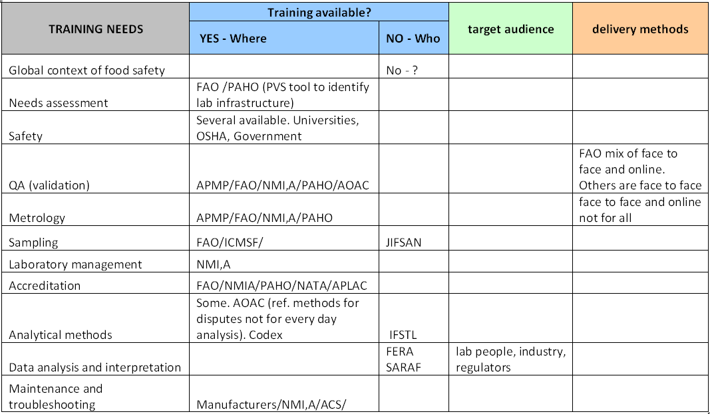
Training Availability

